Slide 1
CS5560 Knowledge Discovery and Management
January 21,2020 – Lecture 1

Slide 2
Videos
IBM Watson: How it Works
https://www.youtube.com/watch?v=_Xcmh1LQB9I
Google's Deep Mind Explained! - Self Learning A.I. (13:44)
https://www.youtube.com/watch?v=TnUYcTuZJpM
Subnets, Deep Learning, and AI for the Enterprise
https://www.youtube.com/watch?v=mQQrzB-rnJ4
IBM Watson: Smartest Machine ever built - Documentary
https://www.youtube.com/watch?v=uDBZnaoJVlk
Knowledge Management and Big Data in Business
https://www.youtube.com/watch?v=TGeoLFueR9U
Knowledge Management Basics
https://www.youtube.com/watch?v=mFNh4jp4yBo

Slide 3




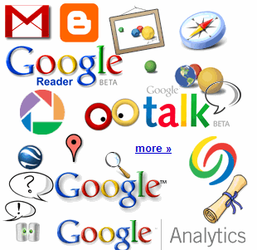

Where Is This “Big Data” Coming From?
30 billion RFID tags today (1.3B in 2005)
4.6 billion camera phones world wide
12+ TBs of tweet data every day
100s of millions of GPS enabled devices sold annually
? TBs of data every day
2+ billion people on the Web by end 2011
25+ TBs of log data every day
76 million smart meters in 2009… 200M by 2014
Notes:
Obviously, there are many other forms and sources of data. Let’s start with the hottest topic associated with Big Data today: social networks. Twitter generates about 12 terabytes a day of tweet data – which is every single day. Now, keep in mind, these numbers are hard to count on, so the point is that they’re big, right? So don’t fixate on the actual number because they change all the time and realize that even if these numbers are out of date in 2 years, it’s at a point where it’s too staggering to handle exclusively using traditional approaches.
+CLICK+
Facebook over a year ago was generating 25 terabytes of log data every day (Facebook log data reference: http://www.datacenterknowledge.com/archives/2009/04/17/a-look-inside-facebooks-data-center/ ) and probably about 7 to 8 terabytes of data that goes up on the Internet.
+CLICK+
Google, who knows? Look at Google Plus, YouTube, Google Maps, and all that kind of stuff. So that’s the left hand of this chart – the social network layer.
+CLICK+
Now let’s get back to instrumentation: there are massive amounts of proliferated technologies that allow us to be more interconnected than in the history of the world – and it just isn’t P2P (people to people) interconnections, it’s M2M (machine to machine) as well. Again, with these numbers, who cares what the current number is, I try to keep them updated, but it’s the point that even if they are out of date, it’s almost unimaginable how large these numbers are. Over 4.6 billion camera phones that leverage built-in GPS to tag the location or your photos, purpose built GPS devices, smart metres. If you recall the bridge that collapsed in Minneapolis a number of years ago in the USA, it was rebuilt with smart sensors inside it that measure the contraction and flex of the concrete based on weather conditions, ice build up, and so much more.
So I didn’t realise how true it was when Sam P launched Smart Planet: I thought it was a marketing play. But truly the world is more instrumented, interconnected, and intelligent than it’s ever been and this capability allows us to address new problems and gain new insight never before thought possible and that’s what the Big Data opportunity is all about!
3

Slide 4
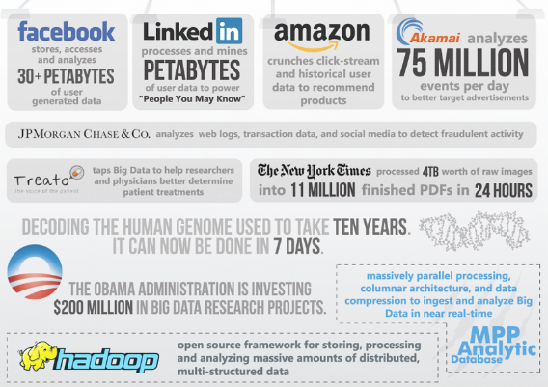
http://wikibon.org/blog/big-data-statistics/

Slide 5
Yottabyte Age
1 kilobyte 1,000 bytes
1 megabyte (1000²) 1,000,000
1 gigabyte (1000³) 1,000,000,000
1 terabyte (1000⁴) 1,000,000,000,000
1 petabyte (1000⁵) 1,000,000,000,000,000
1 exabyte (1000⁶) 1,000,000,000,000,000,000
1 zettabyte (1000⁷) 1,000,000,000,000,000,000,000
1 yottabyte (1000⁸) 1,000,000,000,000,000,000,000,000
5

Slide 6
Big Data in Today’s Business and Technology Environment
2.7 Zetabytes of data exist in the digital universe today. (Source)
235 Terabytes of data has been collected by the U.S. Library of Congress in April 2011. (Source)
The Obama administration is investing $200 million in big data research projects. (Source)
IDC Estimates that by 2020,business transactions on the internet- business-to-business and business-to-consumer – will reach 450 billion per day. (Source)
Facebook stores, accesses, and analyzes 30+ Petabytes of user generated data. (Source)
Akamai analyzes 75 million events per day to better target advertisements. (Source)
94% of Hadoop users perform analytics on large volumes of data not possible before; 88% analyze data in greater detail; while 82% can now retain more of their data. (Source)
Walmart handles more than 1 million customer transactions every hour, which is imported into databases estimated to contain more than 2.5 petabytes of data. (Source)
More than 5 billion people are calling, texting, tweeting and browsing on mobile phones worldwide. (Source)
Decoding the human genome originally took 10 years to process; now it can be achieved in one week. (Source)
In 2008, Google was processing 20,000 terabytes of data (20 petabytes) a day. (Source)
The largest AT&T database boasts titles including the largest volume of data in one unique database (312 terabytes) and the second largest number of rows in a unique database (1.9 trillion), which comprises AT&T’s extensive calling records. (Source)
http://wikibon.org/blog/big-data-statistics/

Slide 7
The Rapid Growth of Unstructured Data
YouTube users upload 48 hours of new video every minute of the day. (Source)
571 new websites are created every minute of the day. (Source)
Brands and organizations on Facebook receive 34,722 Likes every minute of the day. (Source)
100 terabytes of data uploaded daily to Facebook. (Source)
According to Twitter’s own research in early 2012, it sees roughly 175 million tweets every day, and has more than 465 million accounts. (Source)
30 Billion pieces of content shared on Facebook every month. (Source)
Data production will be 44 times greater in 2020 than it was in 2009. (Source)
In late 2011, IDC Digital Universe published a report indicating that some 1.8 zettabytes of data will be created that year. (Source) In other words, the amount of data in the world today is equal to:
Every person in the US tweeting three tweets per minute for 26,976 years.
Every person in the world having more than 215m high-resolution MRI scans a day.
More than 200bn HD movies – which would take a person 47m years to watch.
http://wikibon.org/blog/big-data-statistics/

Slide 8
Unstructured Data
“80 % of business-relevant information originates in unstructured form, primarily text.” (a quote in 2008)
“Based on the industry’s current estimations, unstructured data will occupy 90% of the data by volume in the entire digital space over the next decade.” (a quote in 2010)
“The possibilities for data mining from large text collections are virtually untapped. Text expresses a vast, rich range of information, but encodes this information in a form that is difficult to decipher automatically. For example, it is much more difficult to graphically display textual content than quantitative data.” (Marti Hear, UC Berkeley, 2007)

Slide 9
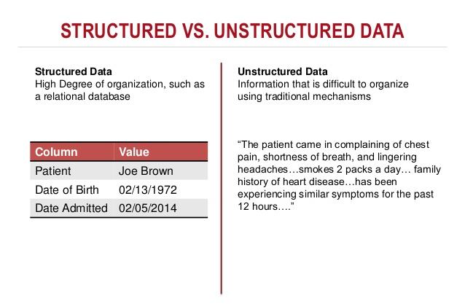
IBM Watson Content Analytics: Discover Hidden Value in Your Unstructured Data

Slide 10
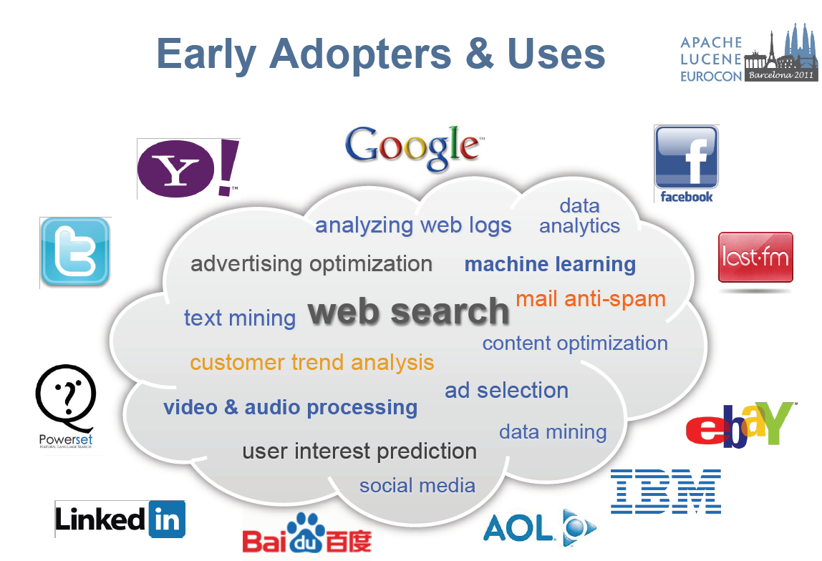

Slide 11

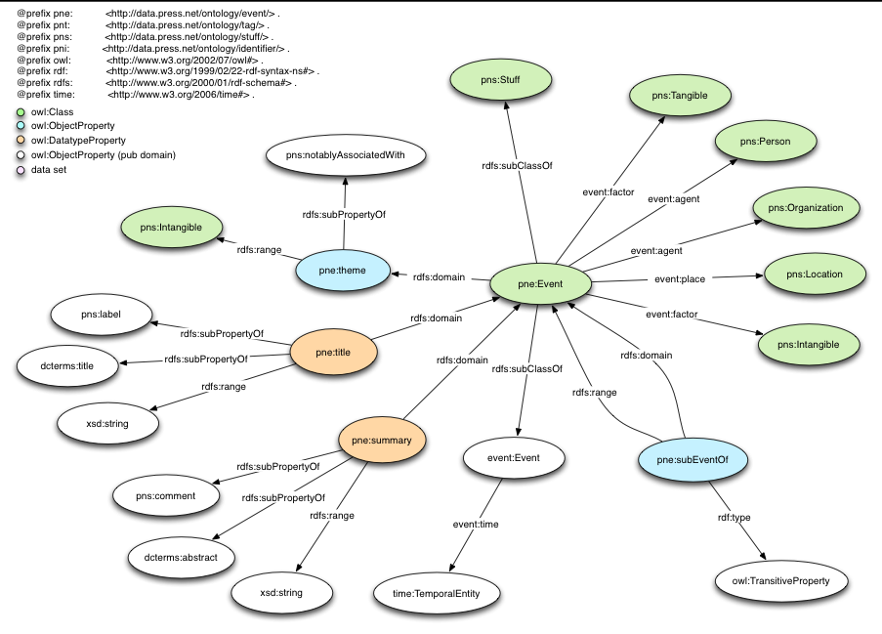

Dynamic Knowledge Graph Construction
How to construct knowledge graphs from unstructured data?

Slide 12
Intelligent Applications
Recommendation
Can we generate intelligent applications using ontologies?
Summarization
Semantic Search
Question
Answering
Intelligent Tutoring
Intelligent Marketing
Personalized Treatment
…

Slide 13

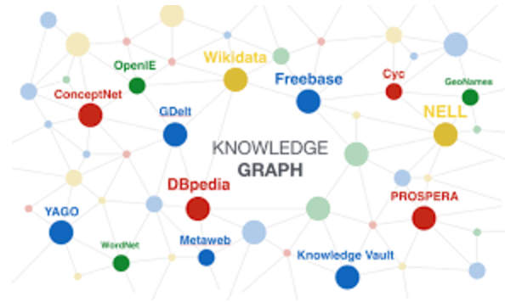
How? From Text to Knowledge Graph

Slide 14

How? From Text to Knowledge Graph
Step 1: Natural Language Processing (NLP)

Slide 15
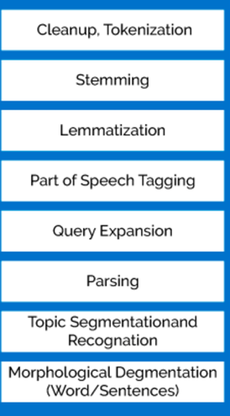
What is NLP?
Sentence
Segmentation
Tokenization
Stemming/Lemmatization
Stopword
N-Gram
Synonym
Part-of-Speech (POS)
Tagging
Name Entity
Recognition
Co-reference
Resolution
Parsing
http://www.datasciencecentral.com/profiles/blogs/overview-of-artificial-intelligence-and-role-of-natural-language

Slide 16
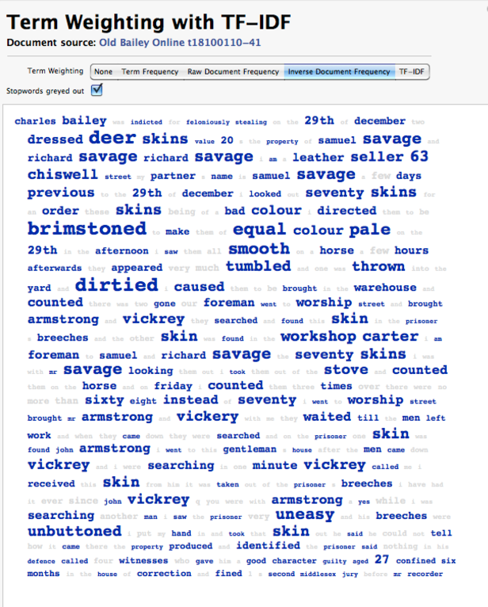
How? From Text to Knowledge Graph
Step 2: Information Retrieval/Information Extraction

Slide 17
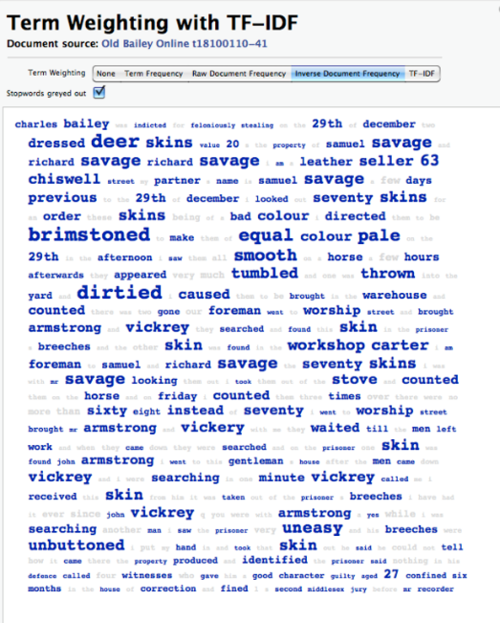
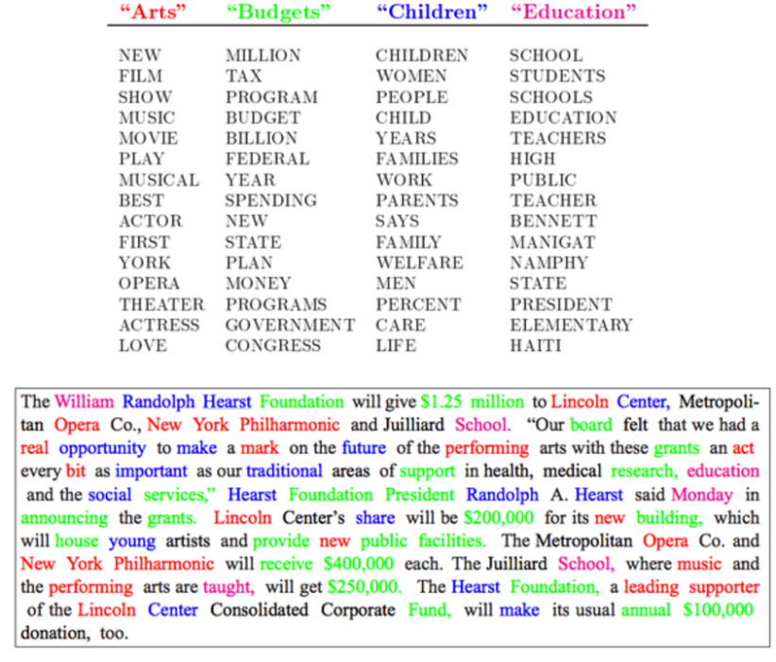
How? From Text to Knowledge Graph
Step 3: Topic Discovery

Slide 18
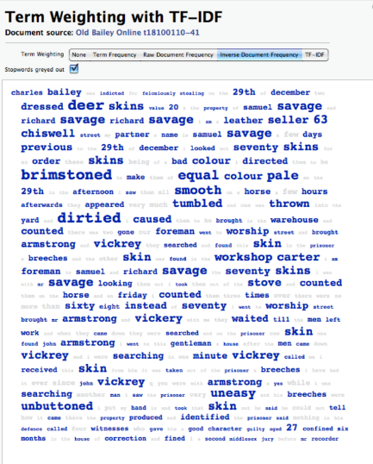
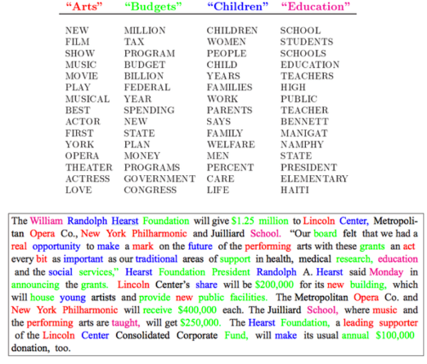
How? From Text to Knowledge Graph
Step 4: Knowledge Graph Construction

Slide 19
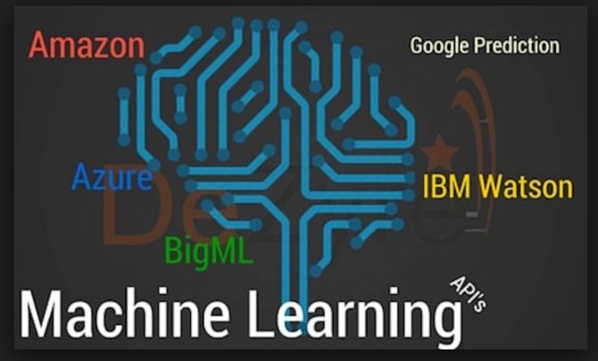
How? From Text to Knowledge Graph
Step 5: Knowledge Graph Refinement
with Machine Learning

